Slide 1
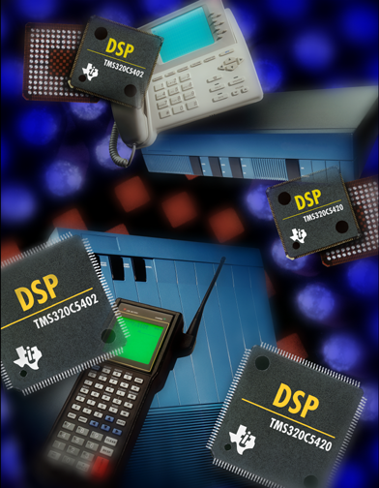
TMS320 One-Day DSP Workshop
For Arizona State University
Texas Instruments
C55x

Slide 2
Administrative Topics
Instructor Introduction
Materials (what’s in front of you and…what you get to take home)
T TO
Technical Training
Organization
Notes:
Since the classes for these workshops will likely be large, there isn’t enough time to have each student introduced themselves.
Explain to the students what materials they have in front of them and what they get to take on.
Take care of logistical items like bathrooms, fire exits, etc.
Have everyone mute or turn off cell phones and pagers.
If anyone has any special needs (for instance if they are hearing or sight impaired) you can shuffle the room around to accommodate them.

Slide 3
Previous Experience ?
Who has experience with…
Code Composer Studio (CCS)?
TMS320, C54x, C55x?
C, Assembly?
DSP/BIOS?
What would you like to learn?
Let’s GO...
T TO
Technical Training
Organization
Notes:
There really is no time for everyone to introduce themselves in a 1-day workshop…so ask for a show of hands for the answers to these questions. This will give you a general feeling for the experience levels in the class and might assist you in pacing the workshop that is appropriate with the experience level.

Slide 4
What Will We Accomplish This Week?
Overview C55x architecture and peripherals
Use Code Composer Studio to edit, build and
debug applications
Analyze and use power reduction techniques
Evaluate methods to maximize performance.
Understand how the Chip Support Library (CSL) is used to set up and program peripherals.
Use BIOS and Real Time Analysis (RTA) tools to build, analyze and debug a DSP system
Run labs/demos using common applications on real hardware (the DSK)
Any other topics that you would like to cover?
T TO
Technical Training
Organization
Notes:
These are today’s main topics. What you need to give to the students are the following two take-away:
the C5000 is extremely powerful
the C5000 is easy to use
It’s usually a good idea to state the relevancy of each topic to ANY application.Also, at the end of the slide, ask “what is missing?” “what else would you like to cover?”. WRITE DOWN THE RESPONSES (on whiteboard/flipchart) If a general topic surfaces, you may have to address this issue later in the workshop. If some issues are “borderline” or “tangents”, use any method of several to get this info to the student (email later, handle it at a break, after class, during lunch, follow up w/MTS), etc. But, the important thing is to capture this info and use an appropriate method to handle the issue.
At the end of the workshop, show this slide again and ask summary questions and ask the students how relevant each topic was to their application.

Slide 5
The Agenda
Intro to C55x DSP, CCS, 5510DSK
C55x Efficiency – High Performance and Low Power
Programming With Ease
Latest and Greatest
Summary
Lab … Use CCS to build and debug code
Demo … Implement/Measure Power Savings Techniques
Lab … Using C compiler/optimizer, CSL, DSP/BIOS
* 30min Instructor Choice
T TO
Technical Training
Organization
Notes:
This agenda supports the accomplishments slide.

Slide 6
Different needs, Many families
C6000
(C62x,C67x,C64x)
C5000
(C54x, C55x)
C3x C4x C8x
Highest
Performance
Multi Channel,
Multi Function
Comm Infrastructure
xDSL
Imaging, Video
’C2000
(C20x,C24x,C28x)
C5x
Highest
Efficiency
Best MIPS per:
milliWatt / Dollar/ Size
Portable and Wireless
Clients
Modems / Telephony
VoIP
C1x C2x
Lowest Cost
Control Systems
Storage
Motor Control
T TO
Technical Training
Organization
Notes:
Here is the obligatory platform road map slide. We added the C55 to the middle box. Below is the marketing explanation:
Given that different applications have different system requirements and therefore different sets of tradeoffs, no one Processor architecture could possibly meet the needs of all of your products and applications. So to provide the most compelling portfolio, TI has worked to build the right DSP architectures to solve unique problems in unique applications . .
NOTE TO SPEAKERS:
You will be reviewing each platform in just a moment, so the purpose of this foil is to focus on why we have the three platforms...
Need to communicate:
1. This answers your need for “tradeoffs.”
2. Highlight what you would sacrifice with only one architecture... and why it’s critical that you have architectures optimized for fundamental application needs
3. Need to instill doubt re: any competitor that does NOT have these optimizations (i.e. why ADI’s single architecture WON’T give you what you need.)
Also, this is not a C6000/2000 class, so don’t spend too much time on these devices in terms of details.

Slide 7
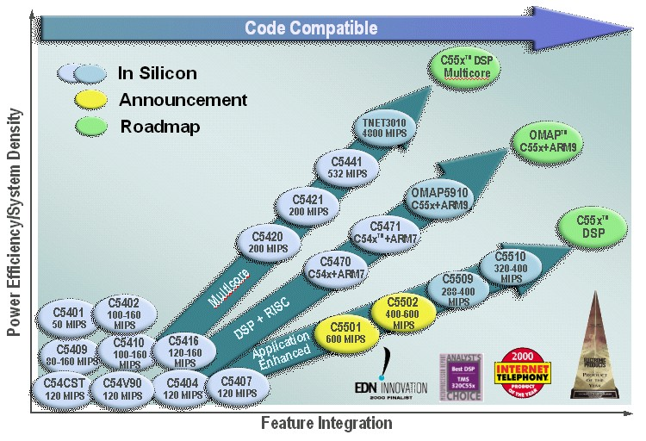
C5000 Roadmap
T TO
Technical Training
Organization
Notes:
Within the C5000 family, TI has MANY options depending on the application, cost, memory requirements, performance, etc. Since this is a C55 class, spend a little time on the lower arrow explaining the devices we have today and where we’re headed. Also, state that the focus will be on the 5510 during the workshop because that is the processor on the DSK.
Note: for information on all TI DSP processors, consult the DSP Selection Guide which should be shipped with the workshop.

Slide 8
Intro to C55x DSP, CCS, 5510DSK
Chapter 1
C55x One-Day Workshop
T TO
Technical Training
Organization
Copyright © 2002 Texas Instruments. All rights reserved.

Slide 9
What Problem Are We Trying To Solve?
DSP
ADC
x
Y
DAC
Digital sampling of an analog signal:
Most DSP algorithms can be expressed with MAC:
count
A
Y = Σ a_{i} * x_{i}
i = 1
for (i = 1; i < count; i++){
sum += m[i] * n[i]; }
t
T TO
How do we solve this problem on the C55x?
Technical Training
Organization
Notes:
Over the next 20 slides, we want to provide an example to anchor the presentation and provide context. What better algorithm than the standard sum-of products. The question lead-in is “so, what problem are we trying to solve?” “The basics of DSP involve first sampling an analog signal and converting it to digital. What do we do then? Some type of algorithm to shape, modify, etc the signal. This is easily done in the digital realm. So, the time between samples is our limit to how fast we need to do the algorithm. What’s a typical algorithm look like - this! A simple sum-of products. Let’s look at a typical DSP algorithm and see how the processor is designed to handle it.
Spend about 1 minute on this slide. If the group is VERY new to DSP, you might embellish slightly on any areas you feel comfortable with. But remember, the focus is not WHY DSP, it is “assuming you know why you’d want to use this algorithm, let’s see how the processor is built to handle it”.
The lead-into the next slide is the Q shown on the slide. Also state that we plan to write the code for this algorithm and see how the architecture is designed to handle it efficiently.
FAQ - what is the difference between a GPP+MAC and a DSP with a MAC? GPP does not have the specialized data bus structure and pipelining to make the MAC or dual-MAC single cycle. The DSP has a HUGE number of data buses (3 read, 2 write) that go to ALL internal memories. GPP MACs are usually multi-cycle just to do a single MAC. The ability of the DSP to pipeline instructions, run code from the internal IBQ, and get access QUICKLY to data - all support single-cycle operations.
OLD INFO

Slide 10
Dual-MAC
Amplitude
Data
Coeffs
a0
2 taps/cycle
a1
a2
Data Read Buses
a3
Time
MAC
MAC
x₄
x₃
x₂
x₁
x₀
t
Results
y0 = a₀x₀ + a₁x₁ + a₂x₂ + a₃x₃
A
AC0
AC1
y1 = a₀x₁ + a₁x₂ + a₂x₃ + a₃x₄
Dual-MAC:
MAC *AR2+, *CDP+, AC0
::
MAC *AR3+, *CDP+, AC1
T TO
Technical Training
Organization
Notes:
THIS SLIDE IS NOT an opportunity to discuss the details of the syntax of the dual-MAC instruction or how block filters work. These issues are covered LATER in the workshop.
The key points here are:
1. Two accumulators needed to accumulate 2 results
2. That the syntax of the dual-MAC instruction supports the equations and leads into the architecture discussion on the next slide
3. Only 3 input buses are needed instead of 4.
If you get a question about CDP getting updated TWICE, say “it’s only updated once” - it’s just part of the syntax of the assembly instruction. Most people think 2 MACs need 4 buses…but the addition of the 4th bus adds power consumption. Because the two data streams use a common coefficient (a0 in the e.g. above), we can avoid using the 4th bus. There are other things you can do as well: If you have one data stream and one filter…you use the method shown above. If you have two data streams and one filter…this works well too - x0 is the first data item in the first array and x1 is the first data item in the 2nd array. Getting even more complex…you could apply TWO filters to the same data stream. X0 and x1 are the first coeff’s of each filter and CDP (a0) is your first data item. Lots of options.
It is VERY important that the students understand this slide and how the dual-MAC operates. Most people are familiar with pointers, so you can ask them to explain it to YOU. The asm instruction helps build the architecture which is expanded on the next slide. Start with the data and coeffs and a single MAC and one accumulator…then visually add in the 2nd data stream, 2nd MAC and 2nd AC.
FAQ - the dual-MAC instruction is 4 bytes long and takes one cycle to execute. There are 422 asm instructions on the C55x ranging from 1-6 bytes long. Almost all are single cycle. The exceptions: branch, call, return. The :: is called “built-in parallelism”. We also support “user-defined parallelism” where the user determines that two instructions can be placed in parallel and does so by using the || symbol between instructions. There are rules that apply, but the details are outside the scope of the workshop.

Slide 11
‘C55x Architecture (10km view)
Program A/D Bus
Data Read Buses (D, B, C)
Instr
Buffer
Queue
A
d
d
r
Gen
PC
ARn
CDP
MAC
MAC
AC0
Decode
AC1
Data Write Buses (E, F)
IU
PU
AU
DU
T TO
MAC *AR2+, *CDP+, AC0 :: MAC *AR3+, *CDP+, AC1
Technical Training
Organization
Notes:
- As you can tell, this is NOT the entire architecture - just the pieces that are required to perform the dual-MAC instruction
- But, but, but, it begins the story of how and why it was designed that way.
- With each animation, try to ask a question that leads them to the next block.
- Try to stay away from getting into any details here. We’re answer most of their questions along the way. Always point the students to a later module if
- Key point here is how the functions are broken into the 4 units and what the basic roles are of each unit. This paints a nice picture for future learning…
It is important to focus on the 3 input buses which can generate two results which requires two write buses. Also, the IBQ. Purpose? To decouple the fetch from execution.
FAQ - the CPU always fetches 4 bytes (32 bits) every cycle into the IBQ. The decoder splits these 4 bytes into instructions - 1-6 bytes and sends them to the “execution unit” - either PU, AU, DU. The avg size of 55x instructions is 3 bytes, so the IBQ is FULL more often than empty. It is VERY difficult to empty the IBQ. This would require a series of 5-6byte instructions which are rare - and typically they are in a loop…which can be executed right out of the IBQ (using RPTBLOCAL asm instr). The IBQ is 64 bytes long. Biggest benefit of VLI? Reduction in code space.

Slide 12
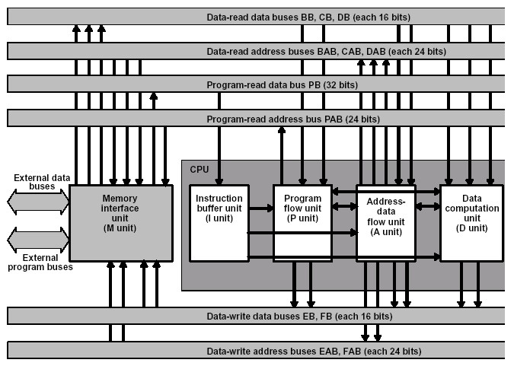
C55x CPU Block Diagram
16Mx8 Unified Memory
Space
C5510 – 160KW RAM
23-bit Addr Regs
Two ALUs (16-, 40-bit)
Dual-MAC
4x40-bit ACC’s
4 Temp Regs
Variable-length Instr
64x8 Instruction Buffer
“Local” repeat block
Dual-level RPT blocks
Multiple Circular Buffers
Built-in + User-defined
parallel instructions
Pipeline Protection
Unit (PPU)
Let’s review the application we’ll be using
throughout the workshop…
Notes:
Some people just like to see the WHOLE thing. Well, here it is. You can point out the items you feel are important, but I really don’t spend much time on it. It is more of a reference. If you have a 54x-experienced group, you might point out some major differences between 54 and 55: unified memory space, dual-MAC, VLI, IBQ, “local” repeat block, PPU, etc. No need to mention every one and spend lots of time.

Slide 13


Audio Application
McBSP2
DMA
CPU
gBufferRcv
Flash LED
P
i
n
g
0
Rcv
RCVCHAN
ADC
P
o
n
g
Hi-pass
Filter
-or-
Copy
3
gBufferXmt
P
i
n
g
Xmt
XMTCHAN
DAC
P
o
n
g
Load
1
Audio Pass thru w/optional hi-pass filter
DSK DIP switches used to control code operation
T TO
Technical Training
Organization
Notes:
Go from input to output explaining the purpose of each block. You can mention some key things that are going on in the lab: channel sorting (L/R stereo input channelized and filtered), DMA automatically handling xfr from SP to buffer, BIOS thread scheduling, periodic function (flash LED) and how the audio goes from in to out. Simple, but yet EVERYTHING must work together.
FAQ - what is the load? This is a function that allows us to load the CPU with a delay - length of delay is variable. You can actually model functions in your system that have not been written yet using this loading function. Why 2 buffers? Because you can’t be transferring into a single buffer AND processing it at the same time - it just doesn’t work. This is a REAL WORLD method of solving timing issues - using 2 or 3 buffers. Why block processing vs. single sample? I control apps, single sample is important (and we can do that on the C55x as well). However, we don’t want to interrupt the CPU for every sample in audio applications - just once per block. This significantly reduces the overhead on the CPU. Why channel sorting? It is difficult to purchase an off-the-shelf filter that can process stereo data. So, let’s channel sort (L separated from R) and filter each individually. The DMA has features that allow this to occur AUTOMATICALLY - with no time overhead.

Slide 14
Software Flow Diagram
dsk_app.c
processBuffer()
Init DSK Board
Init McBSP/AIC
Init DMA
Init Interrupts
Start DMA
BIOS IDL
Determine ping or pong
if ping: copy/filter Ping (in out)
config DMA
toggle LED2
set pingOrPong = Pong
if pong: copy/filter Pong (in out)
config DMA
toggle LED3
set pingOrPong = Ping
out: start DMA’s
DMA
Int
Let’s look at the tools we’ll be using
to build, run, observe the audio application…
T TO
Technical Training
Organization
Notes:
After the main routine, the code returns to BIOS IDL function until the DMA interrupt occurs. When it is triggered, the code is shown that manages the ping/pong buffers. Config DMA is setting the src/dest addr for the next xfr so that when autoinit occurs, the DMA registers are set up properly.

Slide 15
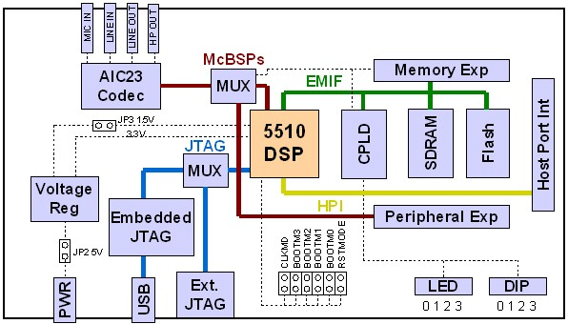
C55x Design Environment
Code Composer Studio (CCS) IDE
PLUGINs
SRC FILES
CODEGEN
Executable
Output File
CDB
BIOS
CSL
Global Settings
Peripheral Setup
Memory Mgmt
Power Down
5510DSK
Periodic Fxns
Thread Scheduling
RTA
Target
CDB - Configuration Database
BIOS - DSP Operating System
CSL - Chip Support Library
RTA - Real Time Analysis (CPU load, statistics, etc)
CODEGEN - Compiler, Assembler, Linker
T TO
Technical Training
Organization
Notes:
This will provide the students with an overview of the entire design environment. CCS is the IDE (Integrated Development Environment) that contains all of the necessary tools to produce an executable output file that can run on a target (e.g. 5510 DSK). We use a ton of acronyms and tools and stuff to get it all done - so, it is important to explain what each piece is and how they interconnect to get the whole job done. SRC FILES are the user’s source files: C code, ASM code, include files, header files, libraries, etc. PLUGIN examples are FlashBurn, Power Analyzer, etc.

Slide 16
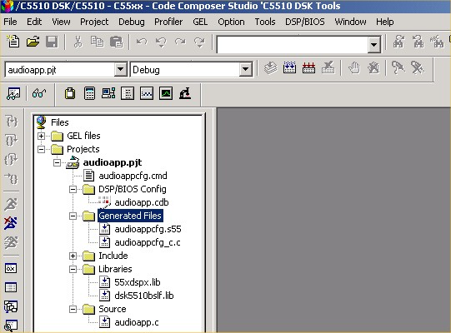
Powerful, Easy-To-Use IDE: CCS
Code Composer Studio
Integrates: edit, code gen, debug
Single-click access using buttons
Powerful graphing/profiling tools
Automates tasks using GEL scripts
Built-in access to BIOS functions
Supports TI or 3rd party plug-ins
What is a Project ?
T TO
Technical Training
Organization
Notes:
a quick screen shot of CCS and some of its most important features. Many customers will be familiar with make files, so the concept of a project won’t be very alien.
Identify the menu bar, horizontal and vertical toolbars and project window

Slide 17
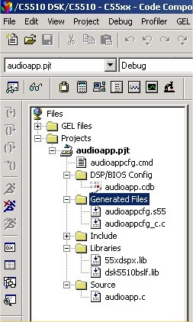
A Project Is...
Code Composer’s .pjt file
Includes all of the necessary
source files to BUILD code
Include (headers, other)
Libraries (run-time support)
Linker Command
Assembly
C
Simply ADD the necessary
files and BUILD to create
an executable output file
T TO
How does CCS know about the user’s resources ?
Technical Training
Organization
Notes:
A quick definition of what a project contains

Slide 18
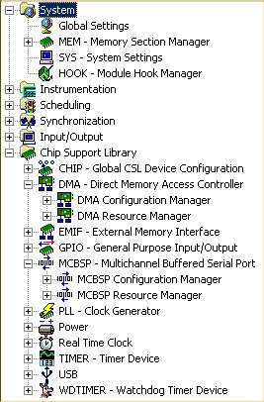
The Configuration File (.cdb)
Used for BIOS and
non-BIOS applications:
Configures BIOS scheduling,
RTA and other BIOS functions
Automatically handles: run-time
support libraries, interrupt
vectors, system reset, etc.
MEM handles system memory
configuration (builds CMD file)
CSL simplifies peripheral setup
Many other capabilities will be
discussed later …
Let’s take a look at the hardware
we’ll be using…
T TO
Technical Training
Organization
Notes:
The cdb file is not just for BIOS. In non-BIOS apps, you can use the cdb for memory mgmt and peripheral setup (CSL). For BIOS apps, you can use scheduling, RTA, etc + the non-BIOS features. The cdb file is central and critical to all code generated for our DSPs. If people want LOTs of details, tell them to sign up for a 4-day BIOS workshop.

Slide 19
C5510 DSK
200MHz C5510 DSP (160 KW internal RAM)
48KHz 16-bit AIC23 stereo codec
8Mbyte SDRAM, 512Kbyte Flash on-board memory
USB connection to host
T TO
DSK box includes: DSK board, power supply, DSK-specific CCS, USB cable, docs
Technical Training
Organization
Notes:
here’s an incomplete overview of the DSK. There is lots more stuff then we care to cover right now. For complete overview referred to the help files.
JTAG - joint test access group
UART - universal asynchronous receiver/transmitter
EMIF - external memory interface
AIC - analog interface circuit
CPLD - Programmable logic device
DAA - Data Access Arrangement: supports direct-line interface to telephone lines.

Slide 20
Efficient Design
Chapter 2
C55x One-Day Workshop
T TO
Technical Training
Organization
Copyright © 2003 Texas Instruments. All rights reserved.

Slide 21
Agenda
Reducing Power Consumption
Using IDLE Modes
APM - Automatic Power Management
Modifying PLL Frequency
Increasing Performance
Internal vs. External Memory
Using a Dual-MAC
Application-Specific Instructions
VLI and Parallelism
Demo - Implement/Measure Efficiency
Notes:
This module is broken into 2 parts - low power & high performance. Of the 5 modules, this is the most important. The focus is on HOW the C55x device achieves both low power and high performance - not just a mktg blurb. Go slow and methodically thru this module - highlighting how each piece fits the students’ real-world applications.

Slide 22
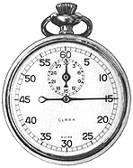
Efficiency - Definition
We want our system to be as “efficient” as
possible – but what does this mean?
Efficiency is comprised of two elements:
“Use the minimum power (watts) …
for the least time (seconds)”
AA
AA
Watts Seconds
= Energy (joules)
In general, what are some ways to reduce power?
T TO
Technical Training
Organization
Notes:
Energy is defined as watt-seconds - the energy (or power consumption) over a period of time. If the wattage goes down over the same period of time, so does the energy. Likewise, more efficient code results in lower energy. So, the goal is to manage power effectively AND increase performance. There are many factors - and we will cover MANY - some are general methods - and others are specific to the C55x. We decided to spend the time on the specific ones.

Slide 23
Reducing Power Consumption
Method Impact Recommendations
Voltage Big
Int vs. Ext Memory Big
Idle Control Reg (ICR) Big
Auto Pwr Mgmt (APM) Big
Frequency Depends
Use min possible (1.0-1.6v)
MHz max applies at lower voltages
Use internal memory when possible
Avoids: EMIF + load + 3.3v mem
Idles specific portions of C55x arch
If resource not being used, turn it off
Auto-idles resources when not used
Match frequency to algorithm needs
How do you use the ICR to idle portions of the C55x architecture?
T TO
Technical Training
Organization
Notes:
We will explore each one of these in detail. Some are general power down methods (memory, voltage, frequency) and others are specific to the C55x - APM and ICR.

Slide 24
C55x IDLE Modes
The ICR (Idle Control Register) determines which portions of the device will be idled (powered down):
ICR
EMIF
CLKGEN
PERI
Cache
DMA
CPU
CLKGEN: PLL clocking
PERI: McBSPs, Timers
Recommendation: if you’re not using a resource for a significant period of time, turn it off.
Three types of power down:
EMIF/Cache/DMA: use ICR to turn off
CPU/CLKGEN: use ICR to turn off, must set wakeup mode
PERI: (2-step process): use ICR and IDLE_EN bit in peripheral
T TO
Let’s look at some examples…
Technical Training
Organization
Notes:
FAQ - what is a “significant time period”? Depends on the application. However, if you’re in task A which is half the CPU performance and you’re not using task B resources, by all means turn them off at the beginning of task A. BIOS IDL is an excellent place to turn everything off - as we do in the demo (except the PLL).
When CLKGEN is OFF, the CPU uses CLKIN to detect the external/NMI interrupt which may affect the external timing of a legal interrupt (2 cycles high, three cycles low).

Slide 25
Power Down Methods (1)
EMIF/Cache/DMA - Use CSL
Example to power down DMA and EMIF:
    PWR_RSET(ICR,PWR_ICR_DMAI_IDLE | PWR_ICR_EMIFI_IDLE);
    PWR_powerDown();
CPU/CLKGEN
Example to power down CPU:
    PWR_RSET(ICR,PWR_ICR_CPUI_IDLE); //set ICR mask
    PWR_powerDown(PWR_WAKEUP_NMI); //apply mask w/IDLE
How does the CPU “wake up” ?
If CLKGEN is enabled (PLL on), any enabled interrupt
If CLKGEN is disabled (PLL off), any external or enabled
McBSP interrupt
Two wakeup modes: _MI (go to ISR); _NMI (next instruction)
T TO
Note: PWR_RSET is a CSL call…we’ll be using the CSL
GUI in the demo to perform the same operation
Technical Training
Organization
Notes:
If you want to turn off the EMIF, cache or DMA, you simply need to write the proper bits to the ICR and turn them off. RSET sets the mask for the ICR and PWR_powerDown applies the mask with the IDLE assembly instruction. To turn them back on, simply re-write the ICR register. The CPU is running, so there’s no issue with running code.
If you power down the CPU, you must make sure you can wake up. The RSET command (in the 2nd example) sets up the mask to apply to the ICR register. PWR_powerDown applies the mask using the IDLE assembly instruction and then manages the INTM (global interrupt enable bit) depending on the wakeup mode selected. If INTM=0 (global interrupts ENABLED), the processor will take the interrupt and go to the ISR. If _NMI is selected (INTM=1, global interrupts are off), CPU begins execution with the next instruction instead of taking the interrupt.
If the PLL is off (CLKGEN is idled), wakeup is the same, but a delay will be caused - potentially up to 30uS for the PLL to turn back on a lock up. Also, WHILE THE PLL IS OFF, the DSPCLK (internal CPU clock) uses the bypass mode and is running at whatever the input frequency is - so be careful to make sure the interrupt that is waking you up from CLKGEN off takes into consideration the new timing of bypass (either div1 or div2 of input clock frequency).
When INTM is turned on or off, this is a major change. So, the OLD value of INTM is preserved and restored after wakeup.

Slide 26
Power Down Methods (2)
PERI - McBSPs and Timers
Powering down these peripherals is a two-step process:
1
Set the IDLE_EN bit in the peripheral before setting ICR
(can be set in the McBSP CSL GUI)
Example: allow idling of McBSPx
PCRx
IDLE_EN
14
0: McBSP is running
1: If ICR PERI = 1, McBSP1 is idled
2
Set the proper bit in ICR to idle PERI domain
To wake the McBSP or Timer up, simply rewrite the ICR
with the proper value (IDLE_EN stays enabled).
What other architectural feature helps reduce power?
T TO
Technical Training
Organization
Notes:
The McBSPs and Timers have an additional bit called IDLE_EN that must be managed if you want to power them down. So, FIRST, you must set the IDLE_EN bit in the peripheral register BEFORE setting the PERI bit in the ICR. If you ONLY set the bit in the ICR and NOT touch the IDLE_EN bit - you have NOT turned off the peripheral. The default state of IDLE_EN is 0 - I.e. no IDLING.

Slide 27
Automatic Power Management (APM)
Switches off resource clock when not in use:
PLL
Mem
EMIF
I-Cache
DMA
Mem
Mem
Periph
User has no control over APM
Auto-idles:
Memory banks (64kw) after 5 cycles of inactivity
All other resources idle immediately (does not idle PLL)
No latency when resource is accessed
APM reduces power significantly…but it is still best
to use ICR to turn off resources if not being used
T TO
What else can help save power?
Technical Training
Organization
Notes:
FAQ - this is a capability that is built in to the C55x and canNOT be controlled by the user. There are not “hits” or “issues” associated with APM and the user can’t do anything to control it. It exists and it is done in the background. However, it helps significantly reduce overall power automatically. We wanted to unearth this capability to show users that we’ve done some of the work for them that is unobtrusive. The rest of the work (and more power savings) comes by using the idle domains - which is intrusive, but must be left to the user to control.
Remember, it is the CLOCK that is turned off to the resource - not the Vdd. So, the memories are still powered, they’re just not clocked. This can be a confusion point.
FAQ - How much power savings can one expect from APM all by itself? 10%. This was proven by running filter code out of SARAM (where APM was applied to the DARAM in the first 64KW. Then, the same filter was run out of DARAM and power was measured and compared to the SARAM measurement.

Slide 28
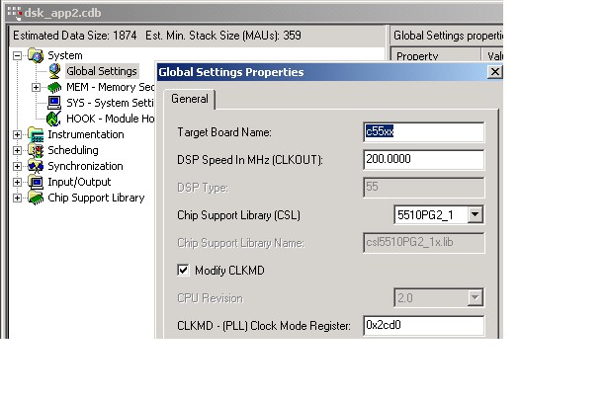
Digital PLL (Phase Lock Loop) Clock
Power ~ freq, to save
power, reduce PLL freq
PLL programmable via
BIOS .cdb settings and
CLKMD Register:
11
7
6
5
PLL MULT
PLL DIV
(2-31)
(0-3) + 1
PLLMULT
In
Out =
*
PLLDIV + 1
5510 DSK:
25
24MHz
200MHz =
*
What are methods
to increase performance?
2 + 1
Auto-lock when PLL becomes stable
Also programmable via CSL dynamically
T TO
Technical Training
Organization
Notes:
At reset, the device samples the CLKMD pin externally. If CLKMD pin is 0, the initial freq = input freq. If CLKMD pin is 1 at reset, initial clk freq = in/2. The PLL operates in two modes: bypass and lock. Bypass is only used if the the user does NOT want the PLL on - and they only get 3 choices in bypass: div1, 2, 4. Most users will program the PLL to the desired frequency - so, we don’t even mention bypass mode. The key to all this is that the user can program any frequency they want given the CLKMD register (mult by 2-31 and div by 1-4). BIOS makes this easy by allowing the user to set up the initial clock frequency in the Global Settings area in the cdb file.
In the demo, we’ll be setting the clk to different values and programming the PLL MULT/DIV fields. This is a “static” implementation - I.e. it’s done before main and the whole system runs from a new frequency. A more powerful method is scaling the freq/volt PER function - that’s what the new BIOS Power Module is all about (more on this later).
FAQ - how long does it take to lock to a new freq? 30us is the max (usually faster)…but that’s what the spec says. The good news is that there is NO hand-holding required of the user. During change of freq, what freq is used? The PLL is placed in bypass mode during lockup, so it is whatever the CLKMD pins are set to - usually div1 - I.e. input = output.

Slide 29
Supplying Power
5v
GPIO0
TPS767D301
Voltage Regulator
CVdd(N)
DVdd(N)
1.6/1.1V
3.3V
VC5510
-200
RSn
Vss(12)
RS
SENSE1
SENSE2
TPS3307-18D
SVS
Diagrams
Simplified
DGND
Vreg: provides 1.6/1.1V for CVdd (core),
3.3V for DVdd (I/O), 2% tolerance
GPIO0 (DSK5510 only) selects core voltage 1.6V (1); 1.1V(0)
Brings both supplies up at once
SVS: 200ms reset delay on power up
SVS: Out-of-tolerance voltage triggers reset
T TO
Technical Training
Organization

Slide 30
Lab Day Agenda
Demo: Implement/Measure Power
Savings Methods
Lab One: Intro to 5510DSK and CCS
Using C Compiler, Optimizer, CSL

